Slide 1
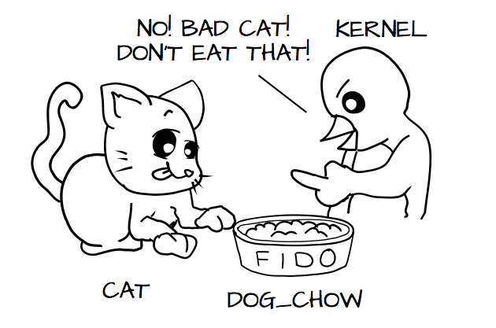
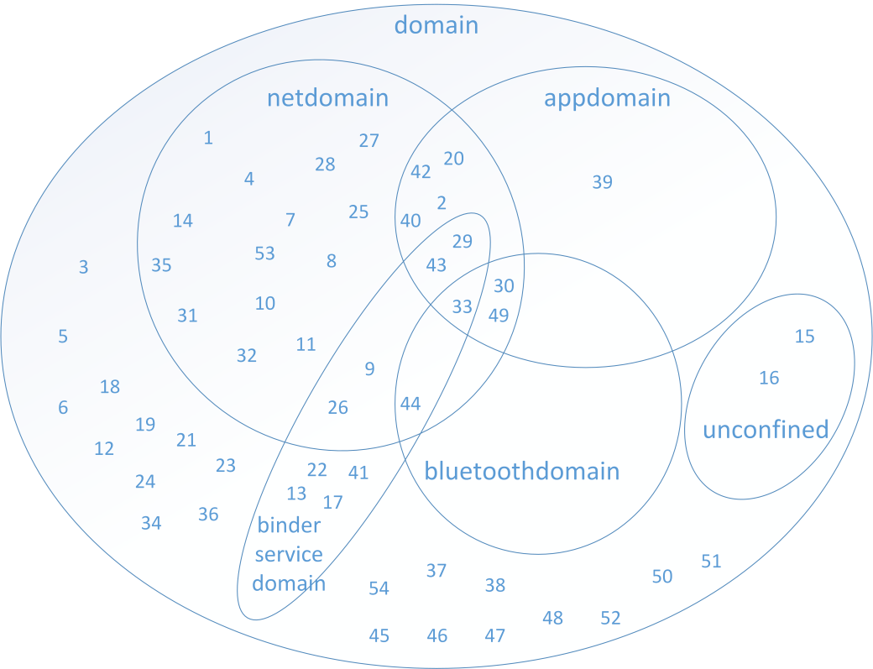
SEAndroid – in 90 minutes
Pic: http://people.redhat.com/duffy/
selinux/selinux-coloring-book_A4-Stapled.pdf
allow dog fido : dog_chow eat
neverallow {domain -dog} fido : * *
pic: Elena Reshtova
Jan-Erik Ekberg
Trustonic, Director of Advanced Development
2.2.2016

Slide 2
Platform Access Control (Linux)
Constrain access to least-privilege
Protect against infection
Multi-user isolation
Multi-app isolation
apps
Android permissions
Java Security
apps
apps
VM
daemons
apps
daemons
syscalls
UID/GID
IMA
FS attributes
Kernel
LSM
Linux capabilities
SELinux
SMACK
FSs
Tomoyo
FS
AppArmor
TPM
eSE
TEE
SIM

Slide 3
Some milestones
(Tech rep 1973) Multics Security Enhancements
    System (kernel) access control
(Usenix 99): The Flask Security Architecture
Access control decision and enforcement separation
(Usenix 01): Meeting Critical Security Objectives with
Security-Enhanced Linux (Loscocco / Smalley)
Domain-type enforcement for Linux (SELinux)
After 3 years of innovation and 15 years of implementation work →SEAndroid

Slide 4
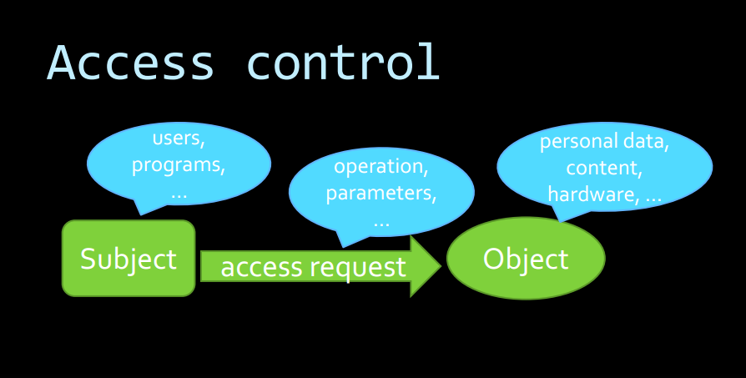
This you already learned ...

Slide 5
Access control mechanisms
Access control lists
Permissions / capabilites
Domain-type
Subjects
Objects
It is all about optimization!
This is a matrix!
The ”thing” that is granted to the subject
for the object (like read, write, delete...) is often,
but not always denoted permission
Other ”interesting avenues”: Role-base access control (RBAC), Low-watermark (security levels), Lattice-based, Discretionary Access Control (DAC) = user access, information-flow based

Slide 6
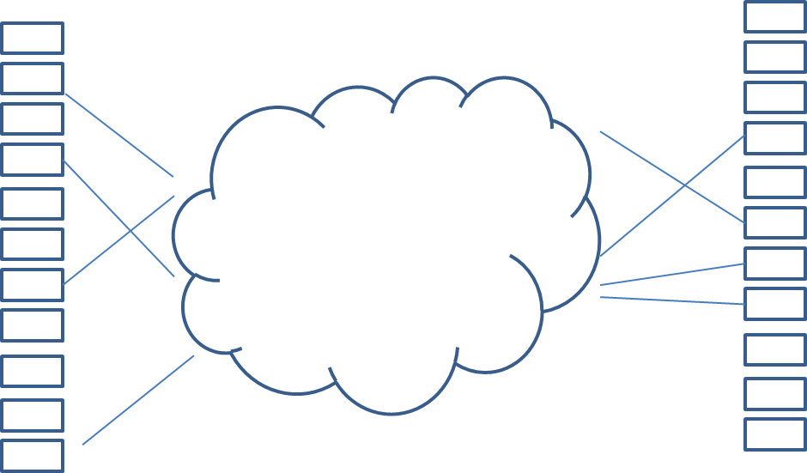
A type is a domain when it is not a type
Not like this: “There is no practical difference between a type and a domain. The policy rules gives them significance. In particular, if an object has the same type as a process' domain, this means something only if the policy explicitly says so (it usually does). All types can be applied to any object since they are just names”
A subject operates on an object, and as an optimization a domain operates on a type
Subject types are domains
Object types are types
SEAndroid types
SEAndroid types
Computing system objects
Computing system objects

Slide 7
Basic principle (dimension 1)
Subjects are primarily processes. Processes that participate in the access control are assigned a domain
Objects are e.g. files, sockets.. Objects that participate in the access control are assigned a type
X processes
(programs, actors)
Y objects
allow
rules
M types
N domains
(also essentially
types)
Allow rules are basically
always between 2 entities
a domain and a type
Domain and types are defined by each policy, and vary. Domain and type names are NOT FIXED by any agreement, i.e. domains and types cannot be counted on to remain consistent in name or meaning across policy generations.

Slide 8
Basic principle (dimension 1B)
In Android, the processes are to a large extent middleware processes running in the Dalvik
virtual machine, and installed by the Android installer. The Middleware MAC (MMAC)
addresses this detail
Issuer (signs program)
allow
rules
N domains
(also essentially
types)
Installer (verifies
program signature)
Running
dalvik process
...
SEAndroid MMAC policy
(key: public keys for programs
values: 1) seinfo→domain,
2) android permission list)
Android subject identity:
Origin (RSA key)
Package name
UID (local)
Filename (system services)
Android permissions
(e.g. access to camera, net, ...)

Slide 9
Basic principle (dimension 2)
An object is always an OS primitive of some sort. This is not a policy issue, this is reality. An object therefore belongs to one or more classes which are predefined by the system proper. A class can be e.g. file, socket, character device, ....
Objects like files, sockets..
Permissions
M types
Class
allow
rules
N domains
(also essentially
types)
A class is associated with a fixed
set of permissions (e.g read, write,
open..), often closely mapped to system call functionality. Again,
the set of available permission is
predefined, policy does not change
that
But! An allow rule includes also the class, and within that the permissions allowed by
the rule. Class and permission names are ”well known” as defined by NSA / SELinux

Slide 10
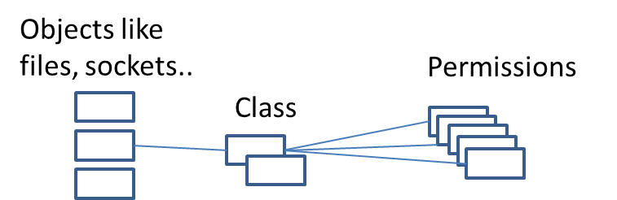
Classes and permissions (examples)
These are more or less defined by
http://selinuxproject.org/page/ObjectClassesPerms
(or in Android source code:
android / platform/external/sepolicy / master / . / access_vectors
A daemon or service provides Unix domain socket access for clients
unix_stream_socket
append, bind, connect, create, write, relabelfrom
ioctl, name_bind, sendto, recv_msg, send_msg
getattr, setattr, accept, getopt, read, setopt, shutdown, recvfrom
lock, relabelto, listen, acceptfrom, connectto, newconn
A device driver (say a serial port) provides device access
chr_file
append, create, execute, write, relabelfrom, link, unlink
ioctl, getattr, setattr, read, rename, lock, relabelto, mounton
quotaon, swapon, audit_access, entrypoint, execmod,
execute_no_trans, open

Slide 11
Class/ Permission illustration
Inside fs/open.c (sys_open syscall)
static int do_dentry_open(struct file *f, int (*open)(struct inode *, struct file *),
const struct cred *cred)
...
error = security_file_open(f, cred);
if (error) goto cleanup_all;
← class ’file’, permission ’open’
Inside security.c (LSM)
int security_file_open(struct file *file, const struct cred *cred) {
int ret;
ret = security_ops->file_open(file, cred);
if (ret) return ret;
return fsnotify_perm(file, MAY_OPEN);
Inside selinux/hooks.c
.file_open = selinux_file_open,

Slide 12
SEAndroid policy allow rules
Since SEAndroid essentially is a single-user system, much of the complexity of users
and roles is collapsed (one user, one role only)
A simple rule (there is in fact more to it) consists of:
ALLOW [domain] [type] : [class] {[ allowed permissions ]}
Class-specific permissions that
are allowed by this rule
Object(a file or other resource)
Subject
(a process in a domain)
Resource class (from predefined set)
The [type] can be self. If applied to an attribute (explained later), it allows only access within each atomic domain, not among all pairs of domains covered by the attribute.

Slide 13
Allow rule examples (from a commercial Android phone)
1) allow untrusteddomain hci_attach_dev : chr_file { ioctl read getattr lock open } ;
2) allow system_app dhcp_data_file : lnk_file { ioctl read getattr lock open } ;
3) allow untrusteddomain system_app : binder { call transfer } ;
4) allow logwrapper dhcp_system_file : dir { ioctl read getattr search open } ;
5) allow healthd healthd_exec : file { read execute entrypoint } ;

Slide 14
Transition rule(sets)
Subjects and objects rules operate according to their domains/types : But how does
a new process get into its domain? (http://selinuxproject.org/page/TypeRules#type_transition_Rule)
code file
(myfile_exec)
File read
Launcher (init_shell_t)
New process
(mydom_t)
fork
exec
Launcher (init_shell_t)
Intent (“what we want to happen”)
type_transition init_shell_t myfile_exec: process mydom_t;
File execution right
allow init_shell_t myfile_exec: file execute;
File type is an entrypoint into a domain (“object firewall”)
allow mydom_t myfile_exec: file entrypoint;
Process type needs transition right into a domain (“subject firewall”)
allow init_shell_t mydom_t: process transition;
Notes:
# Using the type_transition statement to show a domain
# transition (as the statement has the process object class
# in the class).
# The rule states that when a process of type initrc_t executes
# a file of type acct_exec_t, the process type should be changed
# to acct_t if allowed by the policy (i.e. Transition from the
# initrc_t domain to the acc_t domain).
type_transition initrc_t acct_exec_t:process acct_t;
# Note that to be able to transition to the acc_t domain the #
following minimum permissions need to be granted in the policy
# using allow rules (as shown in the [#_allow_Rule allow Rule] section).
# File needs to be executable in the initrc_t domain:
allow initrc_t acct_exec_t:file execute;
# The executable file needs an entry point into the acct_t
# domain:
allow acct_t acct_exec_t:file entrypoint;
# Process needs permission to transition into the acct_t domain: allow initrc_t acct_t:process transition;

Slide 15
File contexts / labeling & transition rule for files
The file contexts file is (in SEAndroid) the source of filesystem labeling
Example lines:
/var/log u:object_r:var_log_t:s0
/dev/block/ram[0-9]* u:object_r:ram_device:s0
/dev(/.*)? u:object_r:device:s0
/system/bin/sh u:object_r:shell_exec:s0
When we want to control the type of files being written (in a shared dir..)
Intent (“what we want to happen”)
type_transition mydom_t var_log_t : file tmp_t;
Right to write to the directory (with type var_log_t)
allow mydom_t var_log_t: dir { add_name write search } ;
Right to write files of type tmp_t
allow mydom_t tmp_t: file { create write };

Slide 16
Context files have more attributes than allow rules
RegExp expansion
Security level
(for MLS)
File contexts
/data/app(/.*)? u:object_r:apk_data_file:s0
File / device name
user
Role (for RBAC)
Type for the object
SEApp
contexts
(different parser, obviously..)
user=_app seinfo=myapp domain=myapp_app type=app_data_file

Slide 17
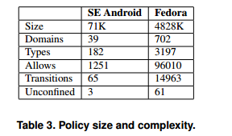
View of one SEAndroid policy
Different kinds of ”targets”
Statistics for policy file: sepolicy
Policy Version & Type: v.26 (binary, mls)
Classes: 84 Permissions: 249
Sensitivities: 1 Categories: 1024
Types: 646 Attributes: 44
Users: 1 Roles: 2
Booleans: 9 Cond. Expr.: 9
Allow: 112271 Neverallow: 0
Auditallow: 0 Dontaudit: 173
Type_trans: 227 Type_change: 0
Type_member: 0 Role allow: 0
Role_trans: 0 Range_trans: 0
Constraints: 63 Validatetrans: 0
Initial SIDs: 27 Fs_use: 16
Genfscon: 18 Portcon: 0
Netifcon: 0 Nodecon: 0
Permissives: 0 Polcap: 2
”target” permissions
rules
Domains
and types
The complexity of
the listed policy is
close to that of Fedora
Smalley & al (SEAndroid)
”domain
entry
rules”

Slide 18
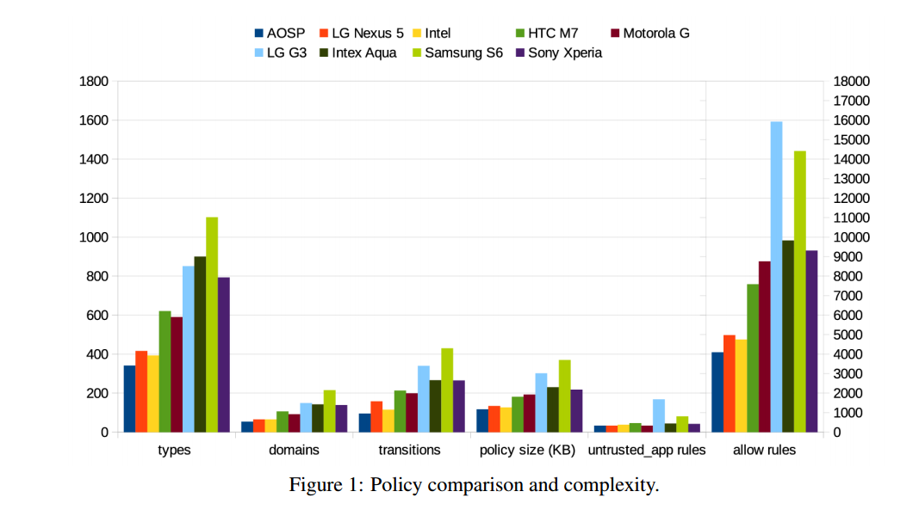
Evaluation in more detail
Characterizing SEAndroid Policies in the Wild
(E Reshetova, F Bonazzi, T Nyman… - arXiv preprint arXiv: …, 2015 - arxiv.org)

Slide 19
System configuration view
property_contexts
(application-enforced
policy)
Android service
Android app
Android app
service_contexts
(android service
policy )
mac_permissions.xml
Dalvik VM
service1
service 2
seapp_contexts
(app, user transition contexts)
sepolicy (binary)
file_contexts
devices
sockets
files

Slide 20
Attributes adds complexity to analysis
Attributes are groups of types (or domains). Rules can also be defined using attributes.
N domains in attributes
(also essentially types)
Examples of
applicable allow rules
M types with attributes
It is typical that class attributes for overall access come from different rules. Say
between a process and a resource, the read rule can come from attributes higher
in the hierarchy, whereas the write access may be specific to individual domains
and types.

Slide 21
mac_permissions
(From comments in the XML file)
A signature is a hex encoded X.509 certificate or a tag defined in keys.conf and is required for each signer tag.
A signer tag may contain a seinfo tag and multiple package stanzas.
A default tag is allowed that can contain policy for all apps not signed with a previously listed cert. It may not contain any inner package stanzas.
Each signer/default/package tag is allowed to contain one seinfo tag. This tag represents additional info that each app can use in setting a SELinux security context on the eventual process.
  <!-- Platform dev key in AOSP -->
  <signer signature="@PLATFORM" >
  <seinfo value="platform" />
  </signer>
  <!-- All other keys -->
  <default>
  <seinfo value="default" />
  </default>

Slide 22
Launching with MAC
Package manifest
Launch
process
Zygote
(launcher)
MyAndroidApp
Domain
transition
MAC permissions
String[] packageNames =
getPackageManager().getPackagesForUid(uid);
try{
PackageInfo pkgInfo = getPackageManager()
.getPackageInfo( packageNames[0],
PackageManager.GET_SIGNATURES);
android.content.pm.Signature[] sigs = pkgInfo.signatures;
Log.i("Signature", sigs[0].toCharsString());
...
In Android, the
PackageManager
is a front-end to
Installer data

Slide 23
”Example” mac_permissions.xml entry
<signer signature=“… 16ef8108a353a9f7300d06092a864886f70d01010b05000382010100
2ae36b53bd209841e4"><allow-all/><seinfo value=“myprog"/></signer>
For the MMAC part of the policy, the applications are bound by origin. I.e. the
mac_permissions.xml contains a hundred or so public keys in x509/DER format encoded as
XML as the example above. The fields are
-- signature: The x509 certificate containing the public part of the application signing key
-- <allow-all/>: The MMAC puts no extra constraints on the android permissions
-- seinfo: A mapping to the domain of the policy
As it happens we find the following line in the seapp_contexts policy file:
user=_app seinfo=myprog domain=myprog_app type=app_data_file
I.e. any application signed with a private RSA key corresponding to the public key mentioned
in a certificate in the mac_permissions.xml that follows the template above, will be mapped
to the trustonicpartner_app domain and be accessible (as an object) in accordance with the
type app_data_file

Slide 24
Android Properties
A policy name resolver for property contexts
A database of configurations and status (like windows registry)
Listed in property_contexts file, e.g.
net.gprs u:object_r:net_radio_prop:s0
selinux. u:object_r:security_prop:s0
Associated with an allow rule, e.g.
allow system security_prop : property_service set
*)
Fixed
Property service calls selabel_lookup ( .., .., ”selinux.reload”, .. )
Lookup finds, and returns *) → u:object_r:security_prop:s0
Service asks policy using selinux_check_access() for source request

Slide 25
Miscellaneous
neverallow rules (assertions)
- a way to shield off unwanted patterns
neverallow { domain -debuggerd -vold -dumpstate -system_server } self:capability sys_ptrace;
dac_override (and other capabilities)
- does show up in policies – one of the 32 linux capabilities
- overrides all ”standard” file permission checks
allow installd installd : capability { dac_override, sys_nice}
unconfined (macro expansion)
- the macros are discussed later. A domain in the attribute unconfined, will be
allowed all (class/permission) access to any type. Shows up as a domain in the final policy
- a testing tool, e.g. to determine interaction with DAC
self (macro expansion)
allow netd self: { tcp_socket udp_socket} *
- As a target, denotes the domain itself, but not any parent attributes

Slide 26
MLS & MCS (layers and contexts)
In recent SEAndroid policy versions, layers and contexts have started to appear. One (two) more orthogonal rulesets to worry
about. (start from http://selinuxproject.org/page/NB_MLS)
Let’s first look at the mechanism:
scontext=u:r:untrusted_app:s0:c523, c778
tcontext=u:r:mydaemon:s1 :c0.c1024
MCS: groups with no order, match
MLS: ordered – levels: s1>s0
Source must dominate target
Subject must dominate object
Source must be dominated by target
Subject must dominate object
subject
subject
read down
write up
object (file)
object (file)

Slide 27
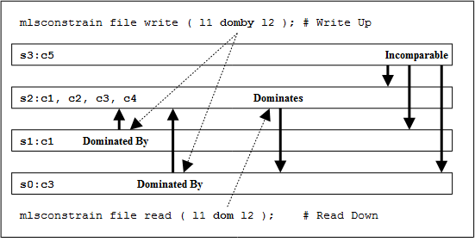
MLS & MCS dominance example
http://selinuxproject.org/~rhaines/NB4-diagrams/9-mls-constrain.png

Slide 28
MLS & MCS (processes)
init scripts:
su -l myuser-c "myCommand args..."
seapp_contexts:
user=myuser domain=mydomain type=app_data_file levelFrom=user
external/libselinux/src/android.c (seapp_context_lookup(...)):
case LEVELFROM_ALL (cur->levelFrom):
snprintf(level, sizeof level, "s0:c%u,c%u,c%u,c%u",
appid & 0xff, 256 + (appid>>8 & 0xff),
512 + (userid & 0xff), 768 + (userid>>8 & 0xff));
setexeccon(3)
proc.
Subject with MLS level
exe file
process
file
setexeccon(3) sets the context
used for the next execve call.
NULL can be passed to setexeccon
to reset to the default policy behavior
(source needs setexec permission ;-)
File with MLS level
setfilecon(3)
domain trans
We could also have (seapp_contexts):
user=myuser domain=mydomain type=app_data_file level=s0:c:512,c768

Slide 29
”My” example use case (TEE)
An application needs access to
a service (with a file store) and a
character driver to provision and talk to a TEE
Android app
Android app
Android app
Provisioning (srv)
Android app
TA
TA
TA
Dalvik VM
Mgmt
Daemon
TEE
Drv2
Drv1
store

Slide 30
Interface needs
Broadcast
Provisioning status notifications
(Intents)
Normal World prog.
Packaged and installed as regular Android APK
Provisioning new SP Containers & TAs
(Binder Service/Intents)
/system/app/RootPA.apk
Provisioning engine
Android System Service
Binder
Service
(AIDL)
UNIX
domain
docket
Internal operations
UNIX
domain
docket
Communicating with SP TA (in TEE)
(dev r/w; ioctl)
Loading
SP TAs
Loading TA; Storage FileAccess
UNIX
domain
docket
UNIX
domain
docket
UNIX
domain
docket
UNIX
domain
docket
/system/bin/mcDriverDaemon
Userspace Daemon
Part of base operating system
Communicating with TA (in TEE)
(dev r/w; ioctl)
Internal operations
(file r/w)
(file r/w)
(dev r/w; ioctl)
(dev r/w; ioctl)
/data/app/mcRegistry
TA Registry + storage
Contains:
TA
Encrypted storage elements
/dev/mobicore-user
User driver
A char device
/dev/mobicore
Control driver
A char device
/system/app/mcRegistry
Fallback Registry
Operating System Kernel
Device Drivers
Filesystem

Slide 31
Interfaces in practice
Userspace daemon
Control driver
/dev/mobicore
mcDriverD 2399 root exe ??? ??? ??? ??? /data/app/mcDriverDaemon
mcDriverD 2399 root 0 ??? ??? ??? ??? /dev/null
mcDriverD 2399 root 1 ??? ??? ??? ??? /dev/null
mcDriverD 2399 root 2 ??? ??? ??? ??? /dev/null
mcDriverD 2399 root 3 ??? ??? ??? ??? /dev/log/main
mcDriverD 2399 root 4 ??? ??? ??? ??? /dev/log/radio
mcDriverD 2399 root 5 ??? ??? ??? ??? /dev/console
mcDriverD 2399 root 6 ??? ??? ??? ??? anon_inode:dmabuf
mcDriverD 2399 root 7 ??? ??? ??? ??? anon_inode:dmabuf
mcDriverD 2399 root 8 ??? ??? ??? ??? /dev/log/events
mcDriverD 2399 root 9 ??? ??? ??? ??? /dev/log/system
mcDriverD 2399 root 10 ??? ??? ??? ??? /dev/mobicore
mcDriverD 2399 root 11 ??? ??? ??? ??? /dev/__properties__ (deleted)
mcDriverD 2399 root 12 ??? ??? ??? ??? socket:[4949]
mcDriverD 2399 root 13 ??? ??? ??? ??? socket:[5325]
mcDriverD 2399 root 14 ??? ??? ??? ??? socket:[5326]
mcDriverD 2399 root 15 ??? ??? ??? ??? /dev/mobicore-user
mcDriverD 2399 root 16 ??? ??? ??? ??? socket:[5328]
mcDriverD 2399 root 17 ??? ??? ??? ??? socket:[5329]
mcDriverD 2399 root 18 ??? ??? ??? ??? socket:[4958]
mcDriverD 2399 root 19 ??? ??? ??? ??? socket:[4960]
User driver
/dev/mobicore-user
Issued (signed) program
someca 2424 root exe ??? ??? ??? ??? /data/app/lta
someca 2424 root 0 ??? ??? ??? ??? /dev/ttySAC2
someca 2424 root 1 ??? ??? ??? ??? /dev/ttySAC2
someca 2424 root 2 ??? ??? ??? ??? /dev/ttySAC2
someca 2424 root 3 ??? ??? ??? ??? /dev/log/main
someca 2424 root 4 ??? ??? ??? ??? /dev/log/radio
someca 2424 root 5 ??? ??? ??? ??? /dev/console
someca 2424 root 6 ??? ??? ??? ??? anon_inode:dmabuf
someca 2424 root 7 ??? ??? ??? ??? anon_inode:dmabuf
someca 2424 root 8 ??? ??? ??? ??? /dev/log/events
someca 2424 root 9 ??? ??? ??? ??? /dev/log/system
someca 2424 root 10 ??? ??? ??? ??? socket:[4957]
someca 2424 root 11 ??? ??? ??? ??? /dev/__properties__ (deleted)
someca 2424 root 12 ??? ??? ??? ??? /dev/mobicore-user
someca 2424 root 13 ??? ??? ??? ??? socket:[4959]
someca 2424 root mem ??? b3:03 0 26948 /data/app/lta
someca 2424 root mem ??? b3:03 16384 26948 /data/app/lta
someca 2424 root mem ??? b3:03 20480 26948 /data/app/lta

Slide 32
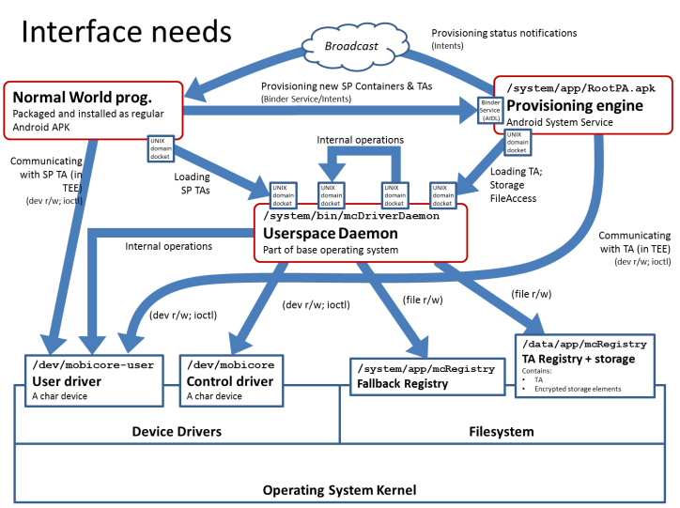
Actual policy left as an exercise
One real-world policy for this setup, with support for virus checkers, file management,
backups etc. has
6 types
852 allow rules
In the exercises you will get, one task is to define a policy for a set-up close to the one above. Simpler, of course...
As the multitude of classes and permissions makes policy
writing ”by hand” tedious and error-prone, Google/Android
has introduced a macro expansion tool, described next...

Slide 33
Google Policy Macros
An m4. macro set for
representing common
rule patterns in a a more
readable format
tee.te
##
# trusted execution environment (tee) daemon
#
type tee, domain;
type tee_exec, exec_type, file_type;
type tee_device, dev_type;
type tee_data_file, file_type, data_file_type;
init_daemon_domain(tee)
allow tee self:capability { dac_override };
allow tee tee_device:chr_file rw_file_perms;
allow tee tee_data_file:dir rw_dir_perms;
allow tee tee_data_file:file create_file_perms;
allow tee self:netlink_socket create_socket_perms;
file_contexts
/dev/tf_driver u:object_r:tee_device:s0
/system/bin/tf_daemon u:object_r:tee_exec:s0

Slide 34
Recursion and relations between policy files
tee.te
allow tee tee_data_file : dir rw_dir_perms;
allow tee tee_data_file : file create_file_perms;
global_macros
define(`rw_file_perms', `{ r_file_perms w_file_perms }')
define(`create_file_perms', `{ create setattr rw_file_perms link_file_perms }')
define(`r_file_perms', `{ getattr open read ioctl lock }')
define(`w_file_perms', `{ open append write }')
define(`link_file_perms', `{ getattr link unlink rename }')
access_vectors
// contains a meta-definition of classes and their relations
// for validating the macro expansion?

Slide 35
te_macros
Contains template rules for some ’special’ operations
define(`domain_trans', `
# Old domain may exec the file and transition tonew domain.
allow $1 $2:file { getattr open read execute };
allow $1 $3:process transition;
# New domain is entered by executing the file.
allow $3 $2:file { entrypoint open read execute getattr };
# New domain can send SIGCHLD to its caller.
allow $3 $1:process sigchld;
# Enable AT_SECURE, i.e. libc secure mode.
dontaudit $1 $3:process noatsecure;
allow $1 $3:process { siginh rlimitinh };
')
define(`domain_auto_trans', `
# Allow the necessary permissions.
domain_trans($1,$2,$3)
# Make the transition occur by default.
type_transition $1 $2:process $3;
')
Similar macros exit for file type transition (based on e.g. dir), binder use (NEW),
and special cases like DRM and debugging

Slide 36
Looking at things
The ”master” SEAndroid branch
https://android.googlesource.com/platform/
external/sepolicy/+/master
/sepolicy , /file_contexts ... on
most Android 4.4 or 5 phones
Google strongly recommends that the policy
files are kept in the root directory of the phone. However alternative locations sometimes apply, especially if the policy is dynamically updatable (http://seandroid.bitbucket.org/PolicyUpdates.html)
Tools for parsing the binary ’sepolicy’
The apol GUI (https://github.com/TresysTechnology/setools3/wiki)
seinfo / sesearch tools in setools (Ubuntu) package
E.g. sesearch –allow sepolicy gives a nice textual dump of all the allow rules
in the provided policy. seinfo –x –t sepolicy gives a list of types and parent attributes

Slide 37
Executive references
Final words (if any) – assignments follow
1) SEAndroid is a ”tweaked” SELinux, with increased functionality
especially for middleware (like the VM)
2) Earlier MAC systems in user devices include Symbian
capabilities and CentOS SELinux. Android 4.4-> SEAndroid is
destined to become the most widespread and complex MAC
ever deployed on consumer devices.
3) SEAndroid policies are inevitably complex and writing them
requires an understanding of both the target environment
AND the policy framework simultaneously.
http://events.linuxfoundation.org/images/stories/pdf/lcna_co2012_smalley.pdf
http://img105.job1001.com/upload/adminnew/2015-04-03/1428012251-T2670AN.pdf

Slide 38
Home assignments 1
The Android Zygote process (http://allenlsy.com/android-kernel-3/ plays an important role in configuring SEAndroid policy for Android applications as they are launched (search for 'security' in the provided link).
a) Give an overview of what SEAndroid policy information Zygote and its associated services are using (and how) when launching new subjects into the system.
b) Why is SELinux/SEAndroid policy enforcement reasonably well applicable to protecting applications (in Dalvik) in Android? Why would not the same hold true e.g. for HTML5 applications in the Chrome browser?
Good friends for all 4 assignments:
http://www.all-things-android.com/content/understanding-se-android-policy-files
http://selinuxproject.org/page/NB_SEforAndroid_1

Slide 39
Home assignments 2
Explore the Google reference SEAndroid policy at
https://android.googlesource.com/platform/external/sepolicy/+/master/
One recent addition to the SEAndroid classes (w.r.t. to SELinux) is the Binder class. In the policy link above you will find an SEAndroid allow rule:
allow untrusted_app untrusted_app : binder { call transfer};
a) What does this rule mean? Who can access / do what ?
- Who are the subjects and targets of this rule ?
b) What services are _not_ permitted (in the permission set) for
the subjects of this rule?
- What might be the reason for not allowing the "missing" parts
to the set of subjects?
c) Opinion? Is the rule above permissive in nature, i.e. do you see a need for its
further constraining in the future? Or are you of the opposite opinion -- that it is
too tight? Motivate!

Slide 40
Home assignments 3
For a given binary policy, possibly a test policy, the command
"seinfo -tuntrusted_app -x sepolicy | less“ gives as a result
untrusted_app
unconfineddomain
bluetoothdomain
netdomain
appdomain
domain
The type "untrusted app" is typically (and also in this case) the type assigned to an Android application that is downloaded and installed from an application store such as Google Play, but for which there is no further guarantee of origin or trustworthiness.
What problems do you see with the policy "snapshot" provided in this question? What might have been the cause of this issue?
Hint: Examine the domains / attributes and what is publicly known about them

Slide 41
Home assignments 4
4. A native daemon "/sbin/mydaemon" (say a TEE daemon) has the following interaction requirements when functional in the Android system:
1) Any (Android) application should be able to connect to it using a local network
socket (say port 6666). The daemon is the binding end, the clients connect to it.
2) The daemon has "its own" configuration/state-keeping directory
(/etc/mydaemon/) to which it, and only it, needs R/W access, i.e. the daemon
manages the files in that directory.
3) The daemon communicates with its HAL through the character device visible at
node /dev/mydriver using ioctls as well as read/writes. Again, the driver-daemon
communication is 1-1, no other system service should be able to access
the character device.
Write a working policy for "mydaemon". The policy should be as constrained (and exclusive) as possible, while still allowing the daemon to operate within the 1), 2) and 3) requirements above. Describe which policy files you need to edit.
You may use Google macros, raw policy commands or a combination
of both to achieve your goal.

